Slide 1
Computer Communication & Networks
Week 4
Datalink Layer: Datalink control and protocols
GitHub - AhmadNawaz110/CE313-Computer-Commincation-and-Network-Spring-2026-
Engr. M Ahmad Nawaz
Engr.ahmad.nawaz@giki.edu.pk

Slide 2

Data Link Layer

Slide 3
Data Link Layer Topics to Cover
Error Detection and Correction
Data Link Control and Protocols
Multiple Access
Local Area Networks
Wireless LANs

Slide 4
Flow & Error Control
The most important responsibilities of the data link layer are flow control and error control. Collectively, these functions are known as data link control.
  Flow control refers to a set of procedures used to restrict the amount of data that the sender can send before waiting for acknowledgment.
  Error control in the data link layer is based on automatic repeat request, which is the retransmission of data.

Slide 5

Protocols (Contd.)

Slide 6
Noisy Channels
We discuss three protocols in this section that use error control.
  Stop & Wait Automatic Repeat Request
  Go-Back-N Automatic Repeat Request
  Selective Repeat Automatic Repeat Request

Slide 7
Stop-and-Wait Automatic Repeat Request
Simplest flow and error control mechanism
The sending device keeps a copy of the last frame transmitted until it receives an acknowledgement
  identification of duplicate transmission (lost or delayed ACK)
a damaged or lost frame is treated in the same way
timers introduced
positive ACK sent only for frames received safe & sound

Slide 8
A Simplex Stop-and-Wait ARQ
Normal operation
The frame is lost
The ACK is lost
The ACK is delayed

Slide 9
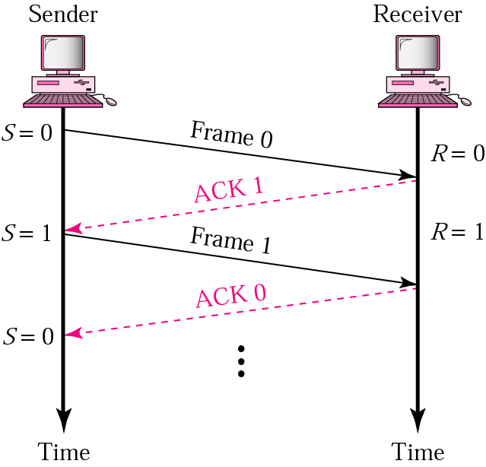
Stop-and-Wait ARQ
-Normal operation-
The sender will not send the next piece of data until it is sure that the current one is correctly received
sequence number necessary to check for duplicated packets
No NACK – when packet is corrupted – duplicate ACKs instead

Slide 10
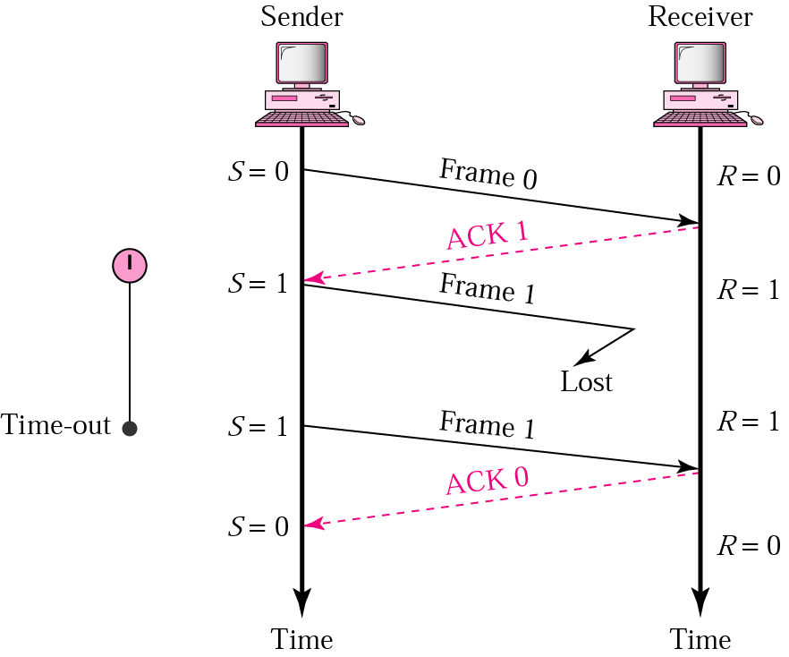
Stop-and-Wait ARQ
-Lost or damaged frame-
roundtrip delay + processing in the receiver

Slide 11
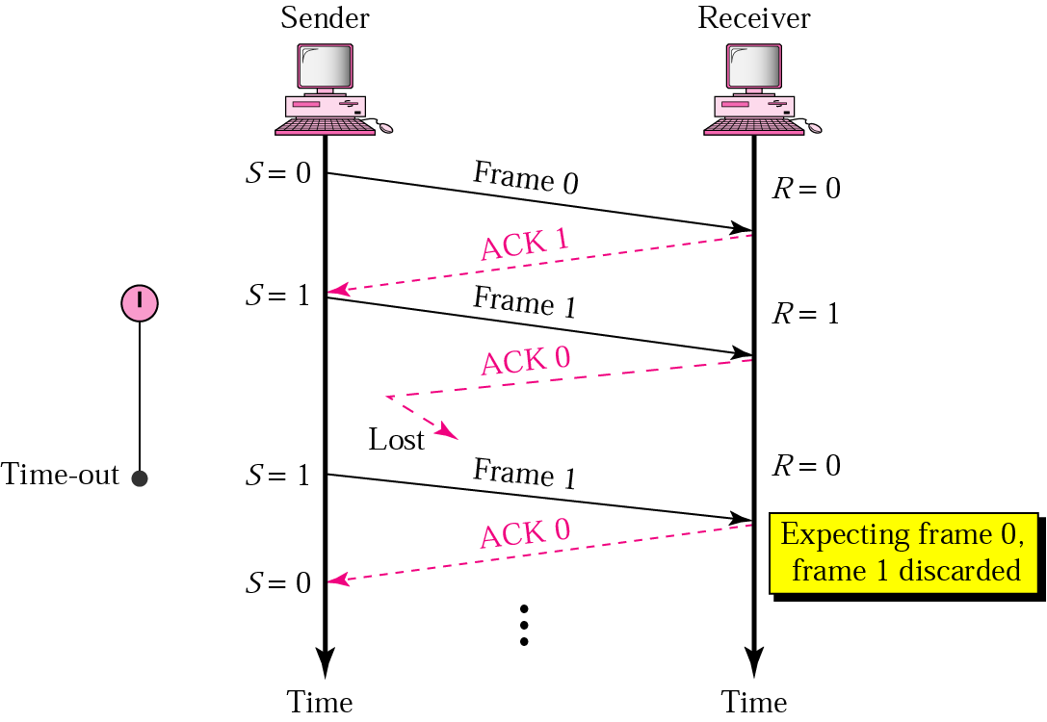
Stop-and-Wait ARQ
-Lost ACK-
Importance of numbering

Slide 12
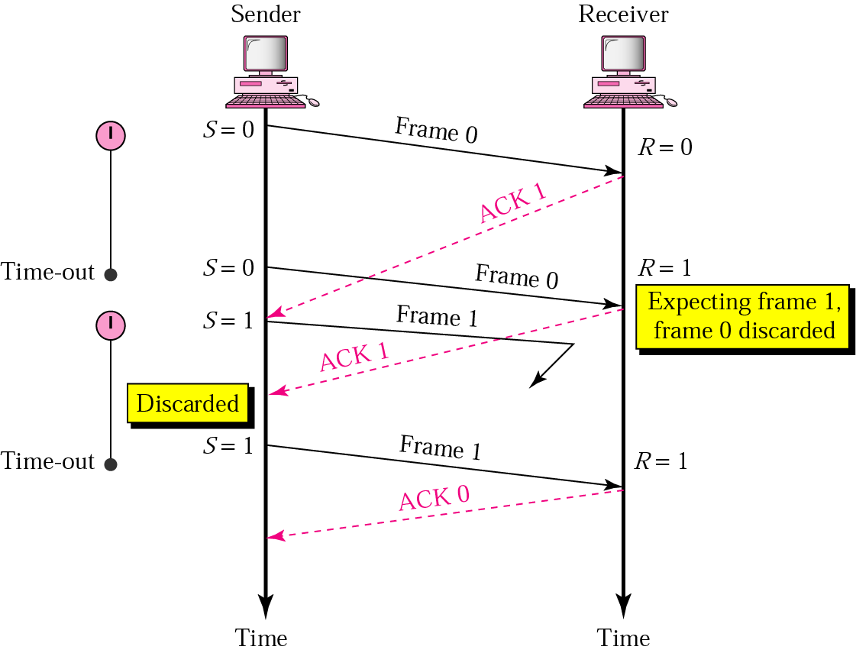
Stop-and-Wait ARQ
-Delayed ACK-
Importance of ACK numbering

Slide 13
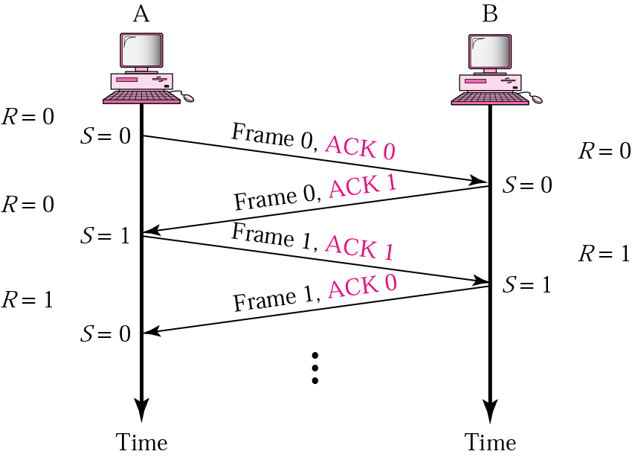
Duplex Stop-and-Wait ARQ
Piggybacking
  combine data with ACK (less overhead saves bandwidth)

Slide 14
Drawbacks of Stop-and-Wait ARQ
After each frame sent the host must wait for an ACK
  inefficient use of bandwidth
To improve efficiency ACK should be sent after multiple frames
Alternatives: Sliding Window protocols
  Go-back-N ARQ
  Selective Repeat ARQ

Slide 15
Pipelining
One task begins before the other one ends
  increases efficiency in transmission
There is no pipelining in Stop-and-Wait ARQ

Slide 16
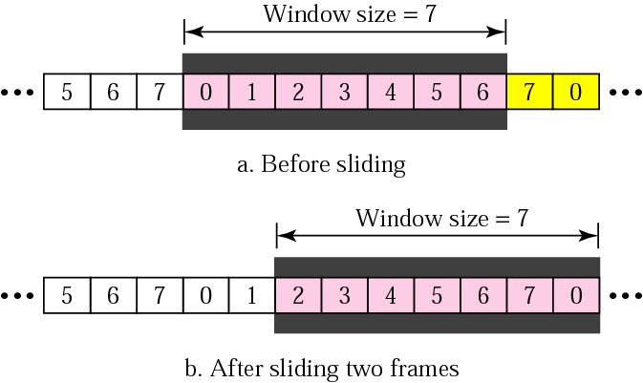
Sliding Window Protocols
Sequence numbers
  sent frames are numbered sequentially
  number of frames stored in the header
    if the number of bits in the header is m than sequence number goes from 0 to 2^m-1
Sliding window
  to hold the unacknowledged
  outstanding frames
  the receiver window size
  always 1
sequence number
frame
acknowledged frames

Slide 17
Question
What is the consequence of the window size in the receiver on the order of the received packets?
Answer:
Window size 1 means that the packets are received in order
  Note: this is not the case for the larger receiver window size

Slide 18
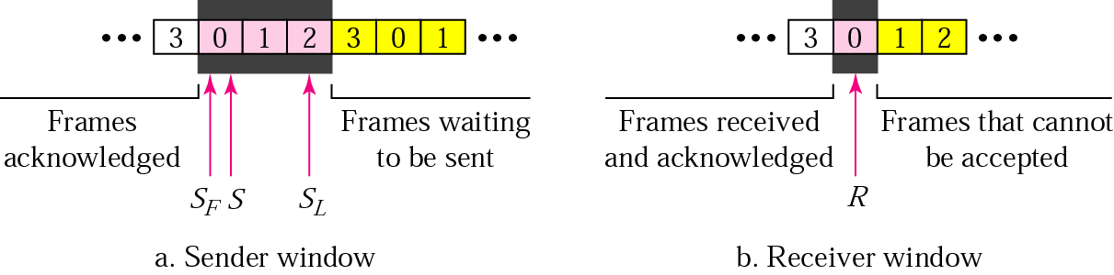
Go-back-N
-Control variables-
S- holds the sequence number of the recently sent frame
SF – holds sequence number of the first frame in the window
SL – holds the sequence number of the last frame
R – sequence number of the frame expected to be received

Slide 19
The name of Go-back-N: why?
Re-sending frame
  when the frame is damaged the sender goes back and sends a set of frames starting from the last one ACKn’d
  the number of retransmitted frames is N
Example:
The window size is 4.
A sender has sent frame 6 and the timer expires for frame 3 (frame 3 not ACKn’d). The sender goes back and re-sends the frames 3, 4, 5 and 6.

Slide 20
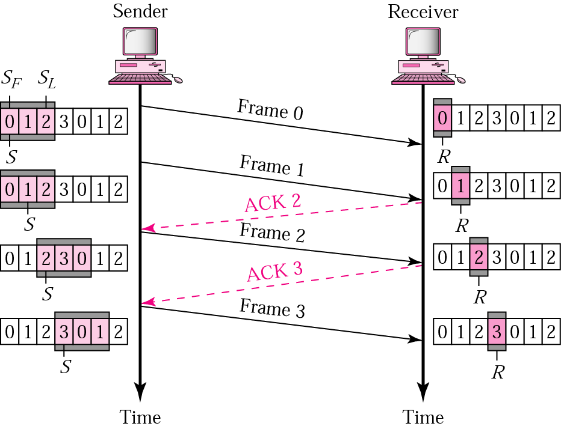
Go-back-N
-normal operation-
How many frames can be transmitted without acknowledgment?
ACK1 – not necessary if ACK2 is sent
  Cumulative ACK
expected sequence number

Slide 21
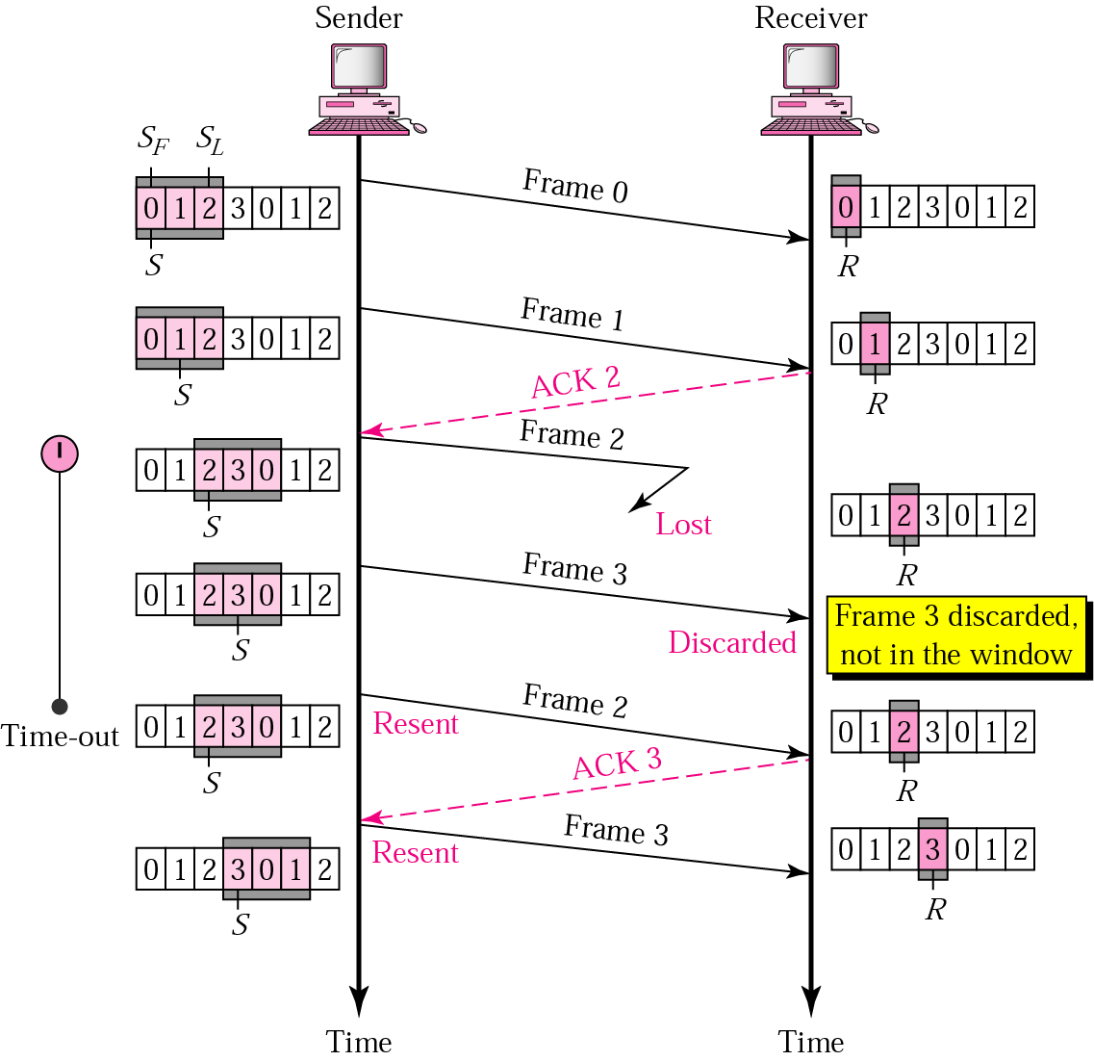
Go-back-N
-damaged or lost frame-
damaged frames are discarded!
Why are correctly received packets not buffered?
What is the disadvantage of this?

Slide 22
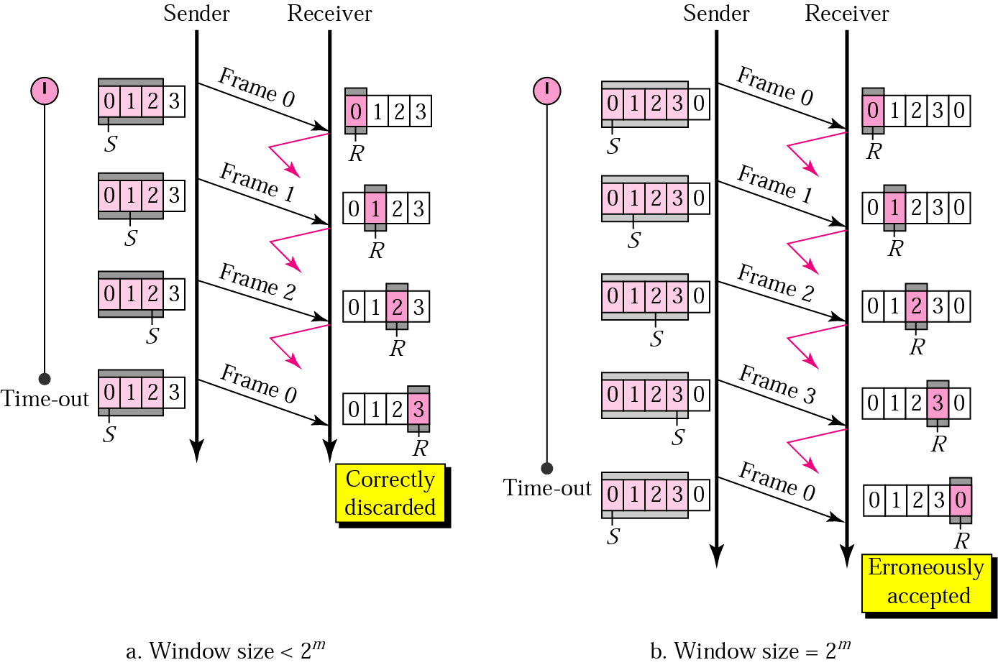
Go-back-N
-sender window size-
sequence number

Slide 23
Go-back-N
Inefficient
  all out of order received packets are discarded
This is a problem in a noisy link
  many frames must be retransmitted -> bandwidth consuming
Solution
  re-send only the damaged frames
Selective Repeat ARQ
  avoid unnecessary retransmissions

Slide 24

Note
Stop-and-Wait ARQ is a special case of Go-Back-N ARQ in which the size of the send window is 1.

Slide 25
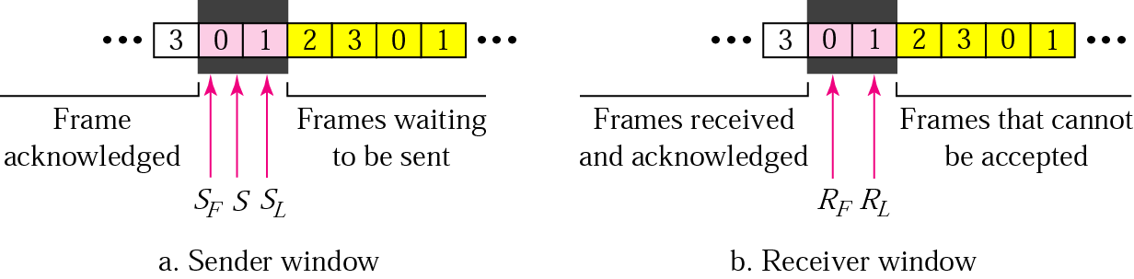
Selective Repeat ARQ
Processing at the receiver more complex
The window size is reduced to one half of 2^{m}
Both the transmitter and the receiver have the same window size
Receiver expects frames within the range of the sequence numbers

Slide 26
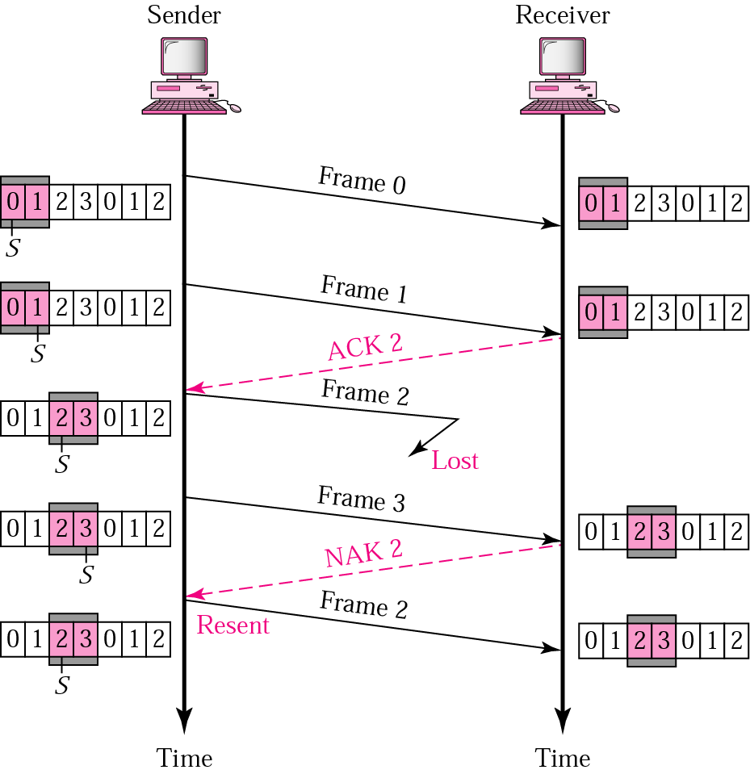
Selective Repeat ARQ
-lost frame-
Note: retransmission triggered with NACK and not with expired timer

Slide 27
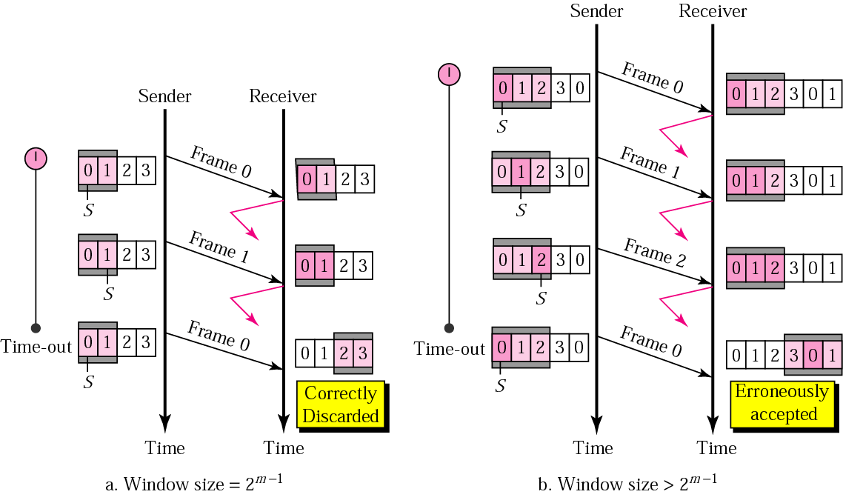
Selective Repeat ARQ
-sender window size-

Slide 28
Readings
Chapter 11 (B.A Forouzan)
  Section 11.2,11.3, 11.5
  (Cover only those contents which are related to topics covered in class)

Slide 29
